Slide 1

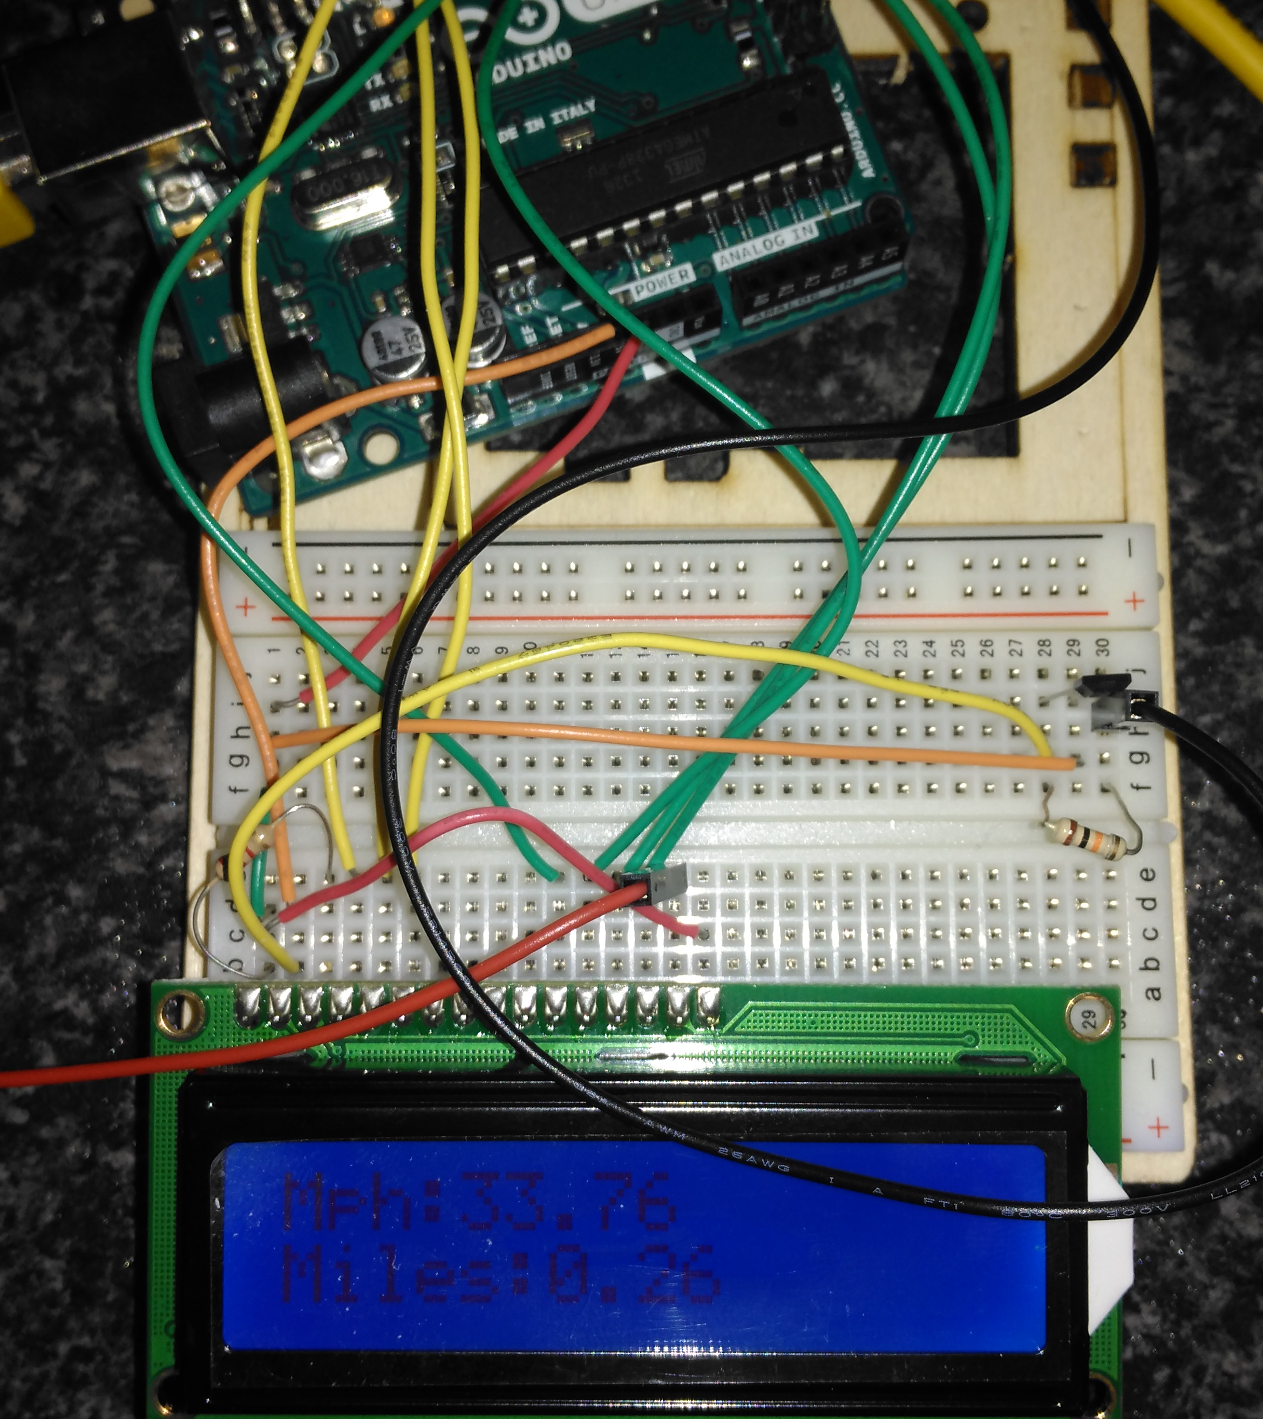
Speeduino
Daniel Collins, 20076240, I.O.T

Slide 2
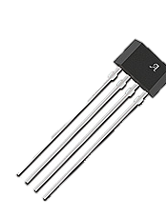
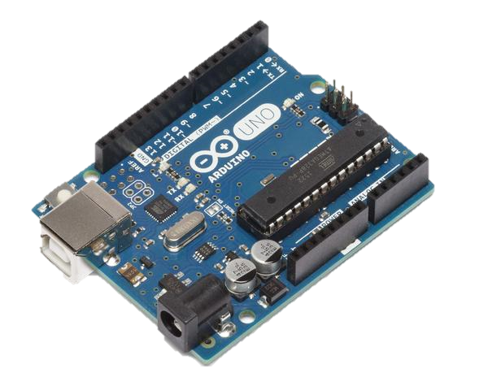
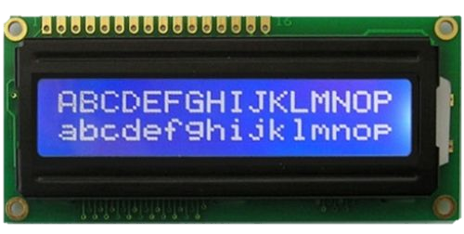
Re-cap
What is it?
Bike Speedometer
LCD
Arduino
Hall Effect Sensor
Magnet

Slide 3
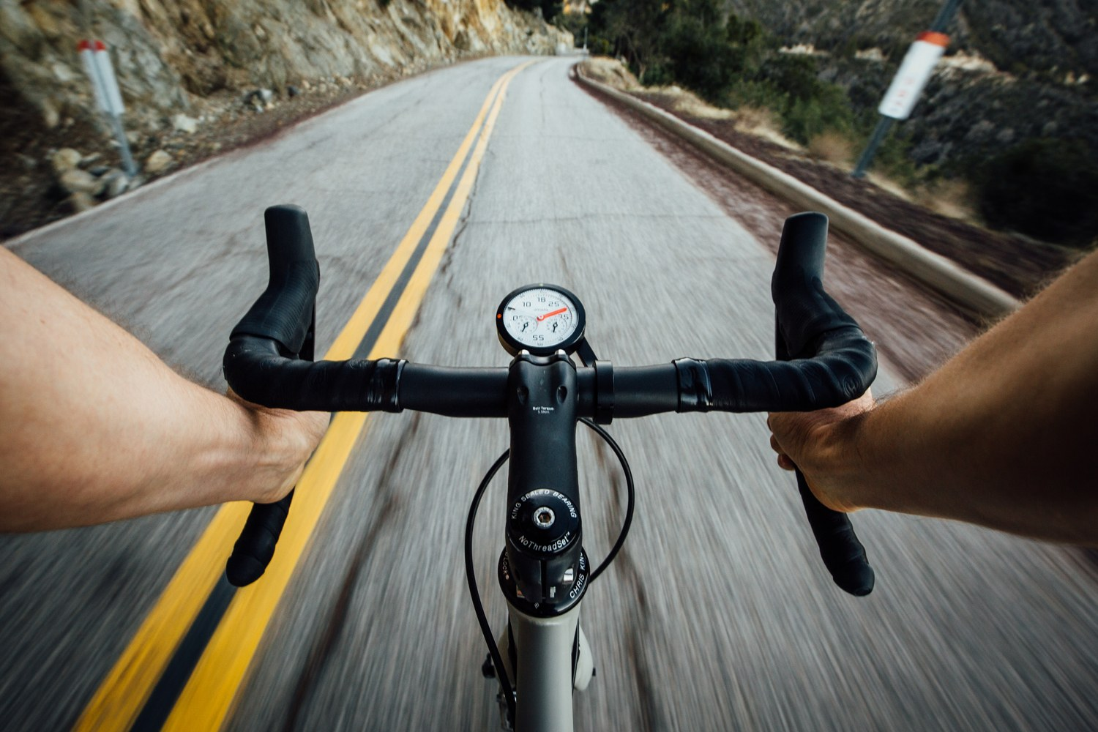
From Previous Presentation
Speedometer for a bike
Inspiration for Idea –
Practicality
Interesting
Challenging
Started with a bit too much ambition….
Settled on a simpler idea

Slide 4
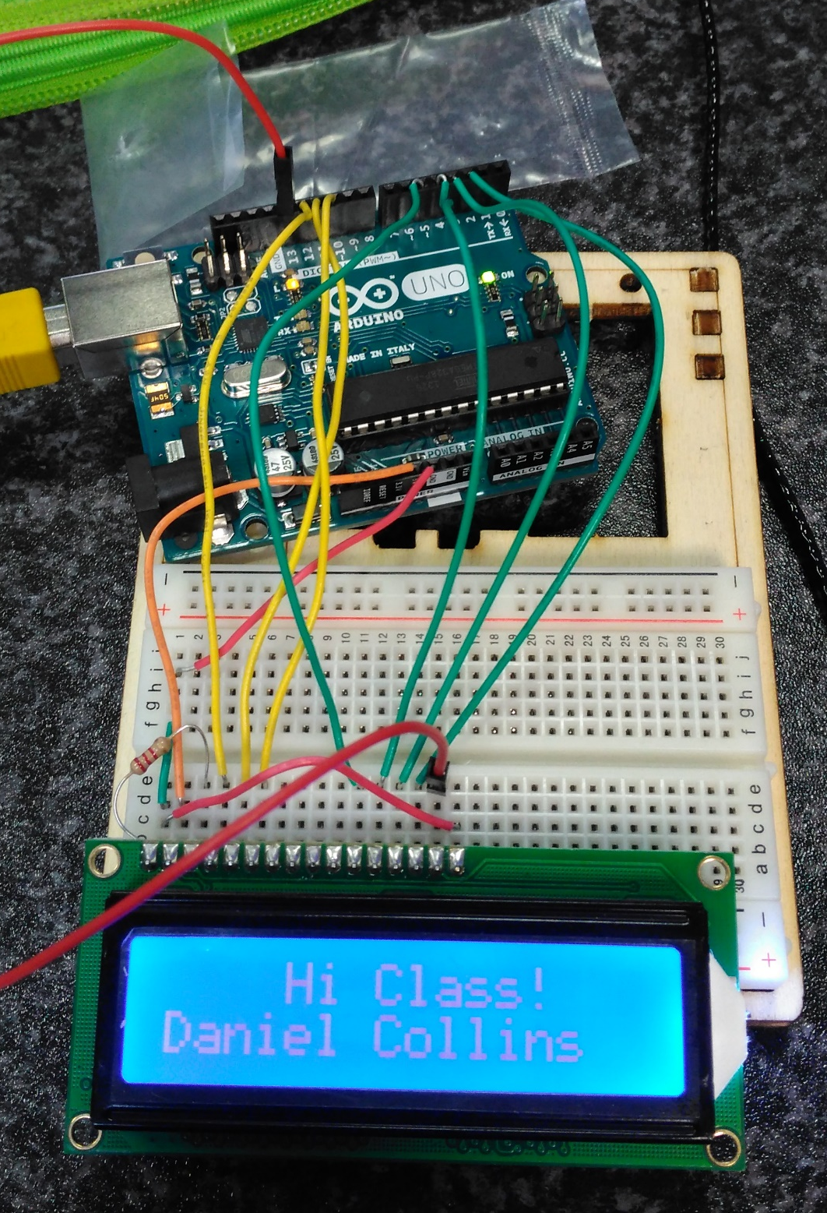
PREVIOUS PROGRESS
Started with the wrong idea
Phone sensors
Wyliodrin
Settled on Bike Speedo
Decided what equipment would be needed
Got LCD working

Slide 5
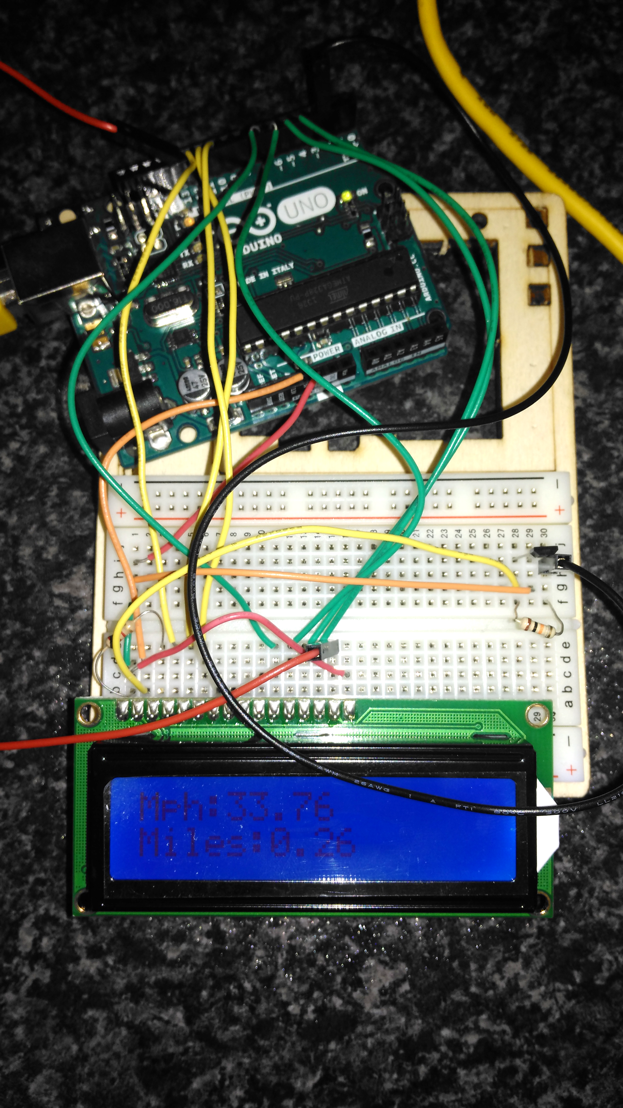

Finished Product
Doesn’t look like much
Hall effect sensor circled
LCD Display Working
Powered By Laptop

Slide 6
Problems encountered
LCD Backlight
Wiring Connections
Battery Pack
Buffer – Storing Values
Extending Hall Effect Sensor

Slide 7
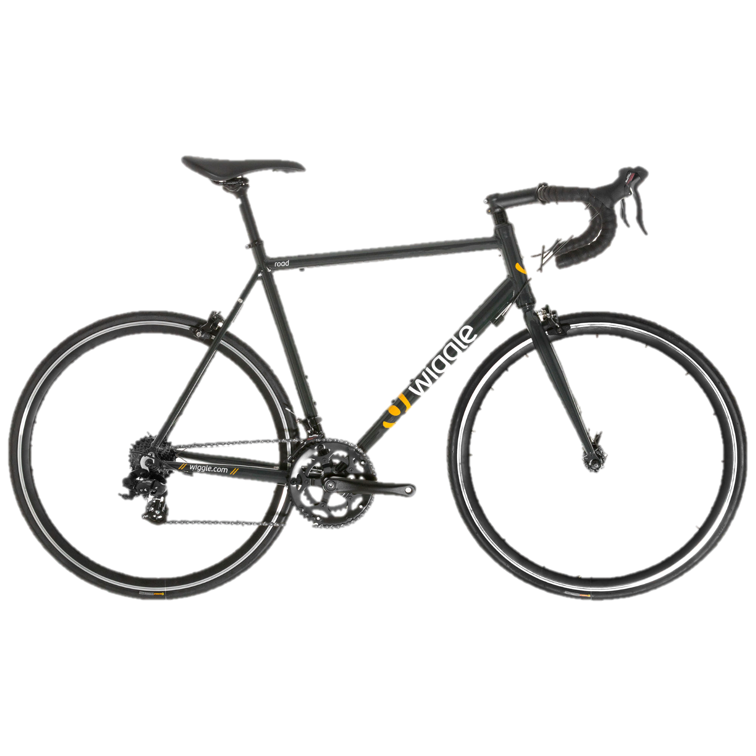
Help and References
Bike Speedometer Tutorial (http://lucidtronix.com/tutorials/13)
Ebay (For purchasing equipment)
RS-Components (For purchasing Hall effect sensor)
A Bike… (For obvious reasons)

Slide 8
Questions?

